Slide 1
Military Veteran Recruiting Initiative
Confidential
Slater Waltz
SRS Distribution
Veteran Recruiting Program Manager
Human Resources

Slide 2
Recruiting & Retaining Veterans
Build relationships with Transition Officers at the various bases
Create Recognition Event to recognize current veterans
Establish strategic partners (Below are all free)
Allies in Service *DFW Only*
Veteran Job Mission Coalition
ESGR- Employee Support of Guard & Reserves
CASY-Corporate America Supports You
Create military specific program brochure
Create military lading page on company career site
Add veteran & military spouse testimonials
Easy to use guide for veterans

Slide 3
Recruiting & Retaining Veterans
Veteran designation on uniform
Publish manager veteran interview guide
Incorporate customers into your veteran strategy
Develop retention programs for veterans
Veteran Mentor Program
Veteran Recognition Program
Involve social media in highlighting various veteran employees

Slide 4
Recruiting: Spring/Summer Base Schedule
March:
• Fort Bragg, NC (3/6)
• Fort Bliss, TX (3/21)
April:
• Travis AF Base, CA (4/4)
• Camp Pendleton, CA (4/25)
June:
• Fort Bragg, NC (6/12)
July:
• Fort Hood, TX (7/11)
• Camp LeJeune, NC (7/18)
• Joint Base Lewis/McChord, WA (7/25)
August:
• Ft Stewart, GA (8/8)
*The various Base Generals support the transition career fairs. More may become available (or known) as that decision is made*

Slide 5
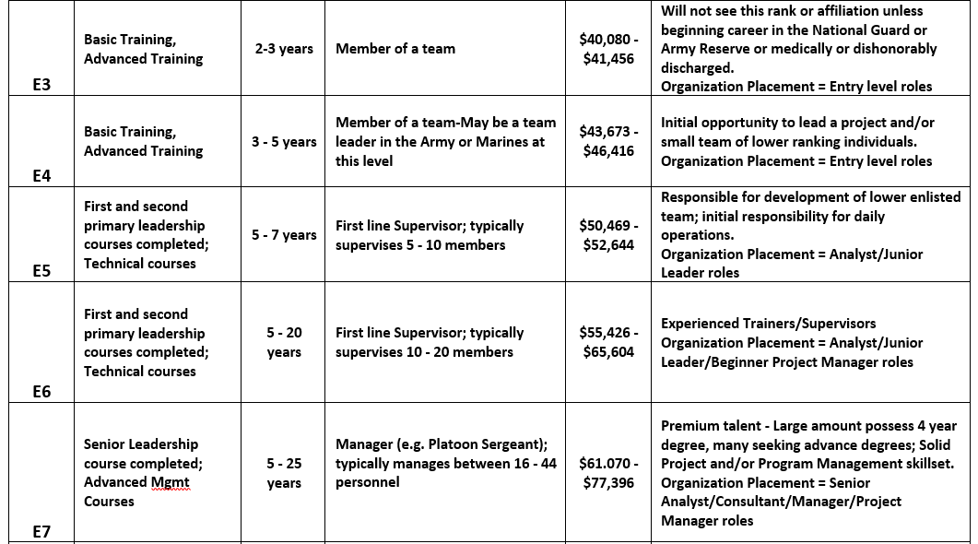
Understanding Military Rank

Slide 6
Veteran Recruiting
SAMPLE: New Hire Orientation Slide
Slater Waltz- Veteran Recruiting Program Manager
SRS recognizes the value of military veterans’ skills and the similarities between their experiences and our business operations, so we are pledging to hire 500 veterans within the next 5 years. As Dan Tinker, President and CEO of SRS Distribution said about military veterans, "Their leadership, teamwork, integrity, self-discipline, and high safety standards are just some of the reasons they will thrive in our branches across the US."
To support this effort, we have created a Veteran Advisory Council consisting of employees from multiple branches of the military, and a new page on our website that is devoted to this initiative srsvets.careers .
The success of SRS and the employees of SRS have benefited greatly from the freedom and protection that our military has and will continue to provide. It is with great honor that we welcome veterans to SRS. We believe veterans deserve a great post-military career with a company that deeply cares for and respects you. We are all proud of your past service and honored by the opportunity to serve alongside our military veterans in the business world.
SRS Raise the Roof Foundation
SRS Raise the Roof Foundation supports our troops in many ways. Here are a few:
Presenting Sponsor to Luke's Wings Heroes Pro-Am for the 5th year in a row.
Supporter of George W. Bush Center's Warrior Open.
Contributor of 22Kill.com "One Tribe. One Fight."

Slide 7
Retention Policies
Example of best in class veteran policies:
Military Leave
Pay differentiator
Tuition Reimbursement
Add a military spouse program to the veteran initiative
Add Veteran’s day as a company recognized holiday

Slide 8
Sample Budget
Vendor | Notes | Timeframe | Cost | Strategic Focus
Troops to Transportation | Located at 6 military installations, CDL Driving school | 2 Quaters/2 Locations | $6,000.00 | CDL positions
Task & Purpose/HirePurpose | Database, Job Posting & Sourcing | 12 months | $6,000.00 | Corporate & Field positions
Recruit Military | Database and Job Posting | 12 months | $6,500.00 | CDL, Corporate & Field positions
Shift** | Apprenticeship for MIT program | Per Month/Per Candidate/3 months | No Cost to TA | MIT apprenticeship
 |  | Total: | $18,500.00
*Shift*This is a break even opportunity as we do not pay the salary of the MIT candidate while with Shift

Slide 9
QUESTIONS

Slide 10
Links to Resources
CASY Veteran Employment
https://www.casy.us/
Veterans Job Mission
https://veteranjobsmission.com/
Employer Support of Guard & Reserves (ESGR)
https://www.esgr.mil/
Service Academy Career Conference
https://sacc-jobfair.com/
MOJO Career Fair
https://militarymojo.org/
Allies in Service (DFW Only)
https://www.alliesinservice.org/

