Slide 1
Telework and Employees with Disabilities During the COVID-19 Pandemic
Tracie DeFreitas Lead Consultant, ADA Specialist
Job Accommodation Network

Slide 2
Telework Questions to Consider
Can the essential functions of the employee’s position, all or any, be performed away from the workplace?
Does the work require in-person interaction with colleagues, clients/patients/customers, and can communication occur in an alternative way?
Will the employee have access to the general equipment, resources, information, etc., needed to perform required tasks at home?
When will the employee be expected to complete tasks and be available to work?
How will the employee be supervised and performance be measured?

Slide 3
Telework as an Accommodation
Pre COVID-19:
Telework as an ADA accommodation:
Modify policy concerning where work is performed, if reasonable and barring undue hardship
Work at Home/Telework as a Reasonable Accommodation (Equal Employment Opportunity Commission, EEOC)
AskJAN.org: A to Z by Topic: Telework
During COVID-19 Pandemic:
Response to state or local stay-at-home order
Telework as an accommodation to avoid risk of exposure
Pandemic Preparedness in the Workplace and the ADA (EEOC), Section III. ADA-compliant Employer Practices for Pandemic Preparedness, Part B, Q. 10

Slide 4
Telework and Accommodations
Pre COVID-19:
Accommodations at home: Complex and not addressed by ADA regulations or formal RA/UH EEOC enforcement guidance (e.g., equipment needed in the home)
During COVID-19 Pandemic:
Pandemic Preparedness in the Workplace and the ADA (EEOC), Section III. ADA-compliant Employer Practices for Pandemic Preparedness, Part B, Q. 14
During a pandemic, if IWD needs the same reasonable accommodation at a telework site that was provided at the workplace, employer should provide that accommodation – absent undue hardship

Slide 5
Telework and Accommodations
During COVID-19 Pandemic, cont’d:
COVID-19 “Ask the EEOC” Webinar (EEOC), Q. 20
Discuss what is needed and why, and whether the same or a different accommodation could suffice in the home setting
Process should be creative and flexible; interim accommodations might be appropriate
What You Should Know About COVID-19 and the ADA… (EEOC), Part D. Reasonable Accomm, Q. 10
May be significantly more difficult to conduct a needs assessment or to acquire certain items, and delivery may be impacted, particularly for employees who may be teleworking

Slide 6
Telework Practical Guidance
Define essential job functions to be performed at home during this pandemic situation
Document parameters of the temporary telework arrangement and draft an agreement (e.g., why and when permitted, for what duration, supervision, etc.)
Make tools, information, and equipment available
Provide accommodations that are reasonable
Provide the support needed to work effectively (e.g., IT)
Develop work goals and performance expectations and apply requirements

Slide 7
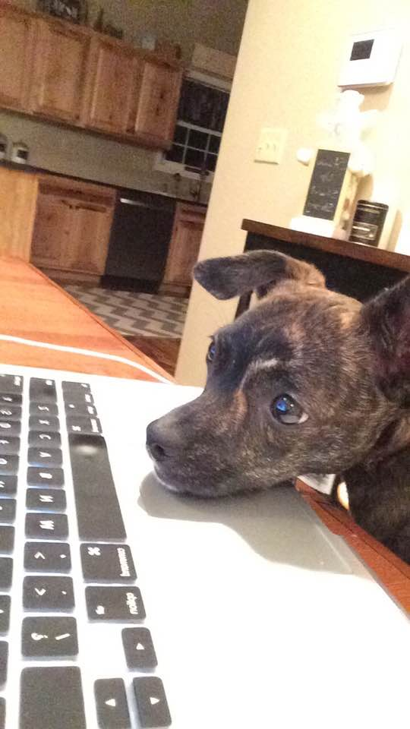
Telework Considerations
Equipment
Electronic equipment needed to access information
Workstation equipment — general
Remote access to information and IT support
USB headset, noise-canceling headset
Access to printer or printing services
Access to productivity tools

Slide 8
Telework Considerations
Equipment
Assistive technology and other equipment needed as accommodation to effectively work at home For example:
Screen magnification software
Screen reading software
Speech recognition software
Smart pen
Adjustable workstations and ergonomic/adjustable chairs
Alternative keyboards and mice
Hearing aid-compatible/amplified headsets
Captioned telephone

Slide 9
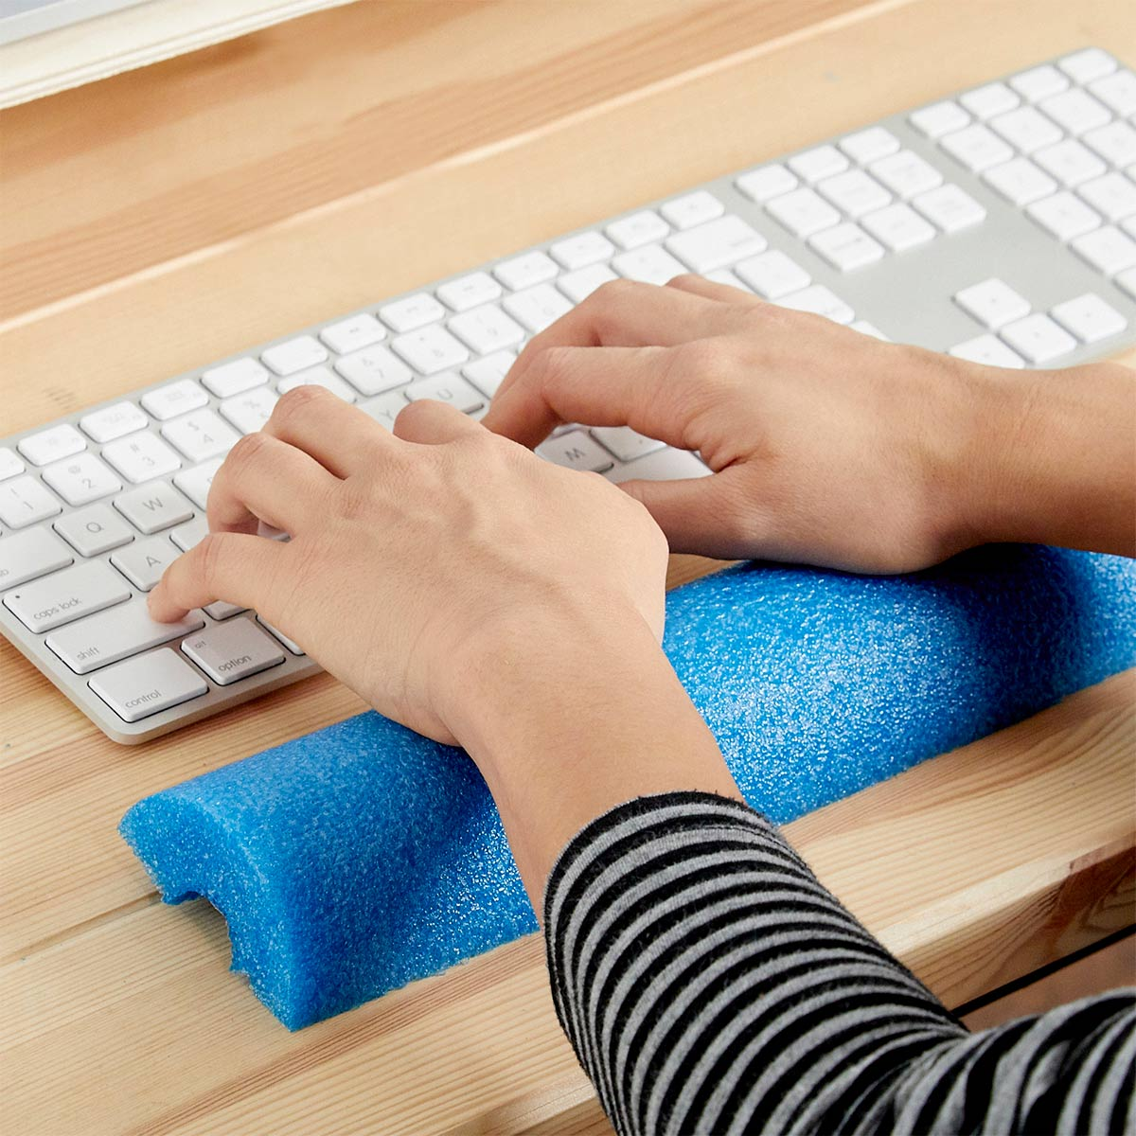
Telework Considerations
Ergonomics: Tips for Home Workstations
When using a laptop, use an external mouse, keyboard, and monitor, when possible
Use workstation equipment that was provided in the office, when possible
Not possible?
Wrist rest — rolled-up tea towel, ½ pool noodle
Foot rest — shoe box
Monitor riser — box of bulk food, shoe box, stacked books

Slide 10
Telework Considerations
Ergonomics: Tips for Home Workstations cont’d
Chair:
Use a rolled towel or pillow for back support
Use a cushion to sit higher, if needed
Use blocks to raise desk if seat cannot be lowered to proper height
Sit/stand workstation:
Stack boxes or books to proper height for standing; move laptop to the boxes/books to alternate sitting and standing
Use kitchen counter to stand periodically

Slide 11
Telework Considerations
Ergonomics
AskJAN.org, A to Z: Topic: Ergonomics in the Workplace
Office ergonomics: Your how-to guide
Ergonomic tips for working from home
Don’t Work from the Couch! Tips to Improve Your Home Office
Your Home Office Is an Ergonomic Time Bomb. Here's How to Make It Better
How to Set Up Your Ergonomic Home Office: Six Essential Ergonomics Tips for Remote Workers
Coronavirus – ergonomics tips for working at home

Slide 12
Telework Considerations
Equipment Delivery & Set-up
Duty to deliver and set-up equipment needed as accommodation for telework?
Not addressed by EEOC
Employer may want to consider using its own resources to insure that the employee receives the appropriate equipment and can use it safely and effectively – but check with legal professional
Safety
Telework.gov — Useful resource; federal government
Self-Assessment & Safety Checklist

Slide 13
Telework Considerations
Staying Connected
E-mail
Make Your Outlook Email Accessible to People with Disabilities
Group texting
Realtime chat
Social media
PEAT: Social Media Accessibility
DigitalGov Social Media Accessibility Toolkit
Digital Accessibility and Telework Resource —
Partnership on Employment & Accessible Technology (PEAT)

Slide 14
Telework Considerations
Staying Connected
Accessible virtual meeting platform
How to Pick an Accessible Virtual Meeting Platform
7 Steps to Make Your Virtual Presentations Accessible
Checklist for Accessible Virtual Meetings and Presentations
Remote captioning (CART) and video remote interpreting services for meetings and training
Conference calls
Relay conference captioning
Video relay services
Captioned telephone

Slide 15
Telework Considerations
Job Restructuring
Remove marginal job tasks
Restructure when duties are performed — most-difficult tasks during the time of day the employee has the most mental energy or stamina/is most productive/is most available
Noise-canceling headset or ear buds to remove distractions, apps for concentration
Communicate in alternative ways (e.g., e-mail, chat)
Designate uninterrupted time for tasks that require significant concentration, specific days for meetings
Take breaks to address mental fatigue

Slide 16
Telework Considerations
Workplace Flexibility
Flexible work schedule
Variable start/finish
Alternative shift
Altering when essential functions are performed
Reduced hours
Flexible and/or scheduled breaks to move around, use the restroom, chat with co-workers, service providers, etc.
Made-up time as needed
Access leave when cannot perform essential duties

Slide 17
Telework Considerations
Services
Job Coaching
Video Remote Interpreting
Remote Real-time Captioning
Qualified Reader
Personal Assistance Services (PAS)
Employee Assistance Program (EAP)

Slide 18
Telework Post COVID-19
Modify policy concerning where work is performed, if reasonable and barring undue hardship
Consider if needed as an accommodation for a disability-related reason
Not required to remove essential functions long term
Temporary telework in response to COVID-19 could serve as a trial period for determining if telework is reasonable and effective
Work at Home/Telework as a Reasonable Accommodation (EEOC)
AskJAN.org: A to Z by Topic: Telework

Slide 19
COVID-19 Workplace Resources
JAN COVID-19 resource page
Engaging in the Interactive Process During the Covid-19 Pandemic
The ADA and Managing Reasonable Accommodation Requests from Employees with Disabilities in Response to COVID-19
Coronavirus (COVID-19), Stress, and Mental Health Conditions
Teleconference Accessibility and Hearing - Keeping Deaf and Hard of Hearing Employees in the Loop
Pandemic Preparedness in the Workplace and the ADA (EEOC)
What You Should Know About COVID-19 and the ADA, the Rehabilitation Act, and Other EEO Laws (EEOC)
EEOC webinar addressing questions arising under Federal Equal Employment Opportunity laws and the COVID-19 pandemic

Slide 20
Ask JAN!
Tracie DeFreitas Lead Consultant, ADA Specialist Job Accommodation Network (JAN) defreitas@jan.wvu.edu
AskJAN.org - Live chat
jan@askjan.org
(800) 526-7234 (V) - (877) 781-9403 (TTY)
(304) 216-8189 via Text

